Slide 1
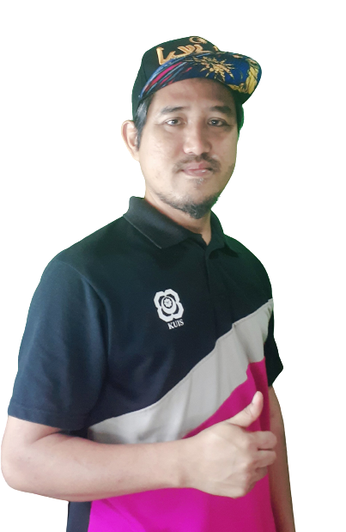



Laravel8 &Login UI khirulnizam.com

Slide 2
Laravel Project Installation
Laravel 8 Project using Laragon
composer create-project laravel/laravel laravel8 8.5
Laravel/UI package
composer require laravel/ui
Auth scaffolding
php artisan ui bootstrap
php artisan ui bootstrap --auth
NPM install/ run dev
npm install webpack
npm install
npm install && npm run dev
Test auth UI
laraproject.test/login
laraproject.test/register

Slide 3
Laravel Project
6. Database – additional users table migrate
php artisan migrate
7. Test again to register / login

Slide 4

Laravel 01 Bina Projek Laravel Pemula

Slide 5
Module Outcome
Day 1
Create Laravel Project
Working with Database.
Working with Model
Working with Controllers
Working with Views
What will be needed
Laragon
phpMyAdmin
VS Code

Slide 6
routes/web.php
app/Http/Controllers
app/Models
resources/views
Notes:
In Slide Show mode, select the arrows to visit links.

Slide 7
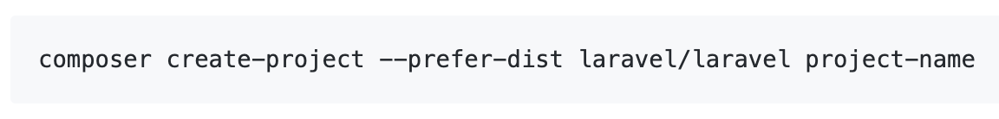

Create Laravel First Project
Install Laravel by issuing the Composer create-project command in your terminal

Slide 8
laragon.org
With Laragon?
Never been EASIER.

Slide 9
Laragon
What is Laragon? Laragon is a portable, isolated, fast & powerful universal development environment for PHP, Node.js, Python, Java, Go, Ruby. It is fast, lightweight, easy-to-use and easy-to-extend. Why Laragon? Laragon is great for building and managing modern web applications. It is focused on performance - designed around stability, simplicity, flexibility and freedom. Laragon improves web development. Developers all over the world are using Laragon to make apps quickly and easily. It is used by thousands of developers with loves. You can check out the Testimonials to see how users think of Laragon and it’s features page for more details.

Slide 10
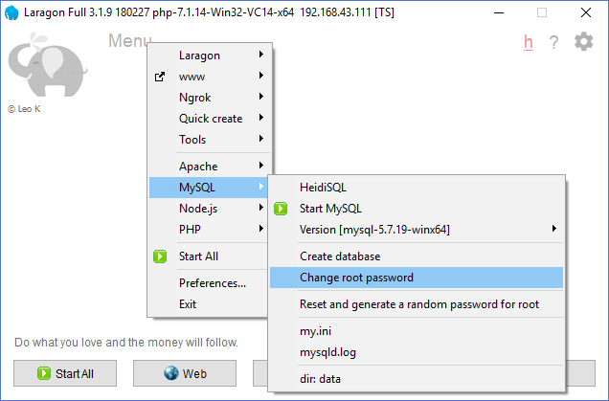
Change DB root password

Slide 11
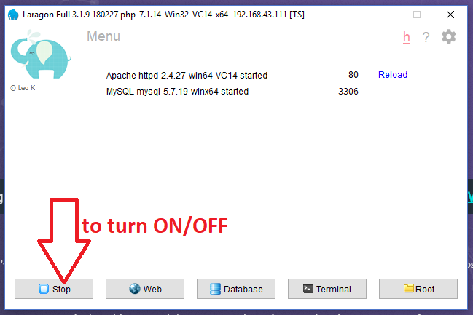
Turn On Laragon
By default Laragon will served port 80 for Apache and port 3306 for DB

Slide 12
Create Project

Slide 13
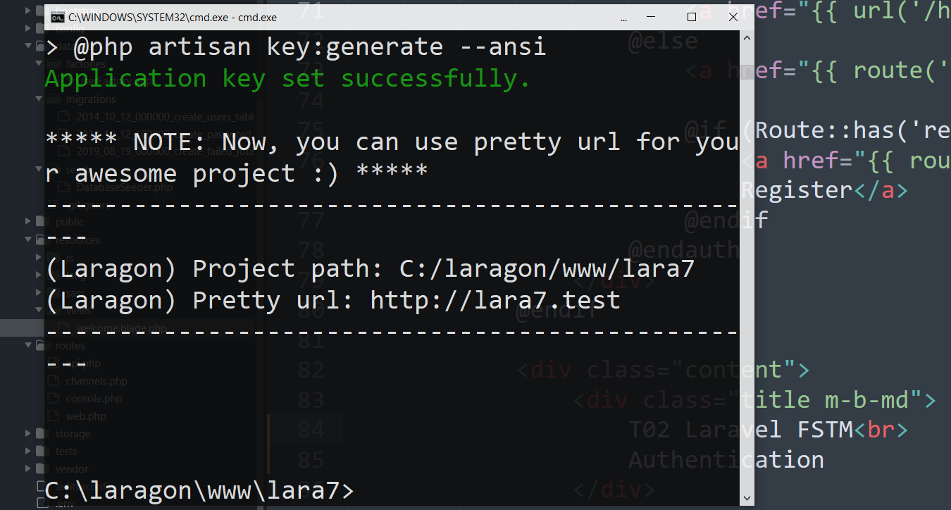
Laravel project with Pretty URL
Test the Pretty url in browser

Slide 14
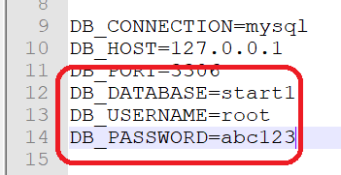
Update DB credentials in .env

Slide 15
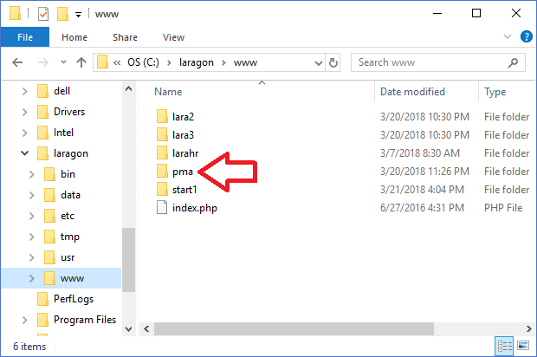
Download and install phpmyadmin.Net
Try access
http://localhost/pma

Slide 16
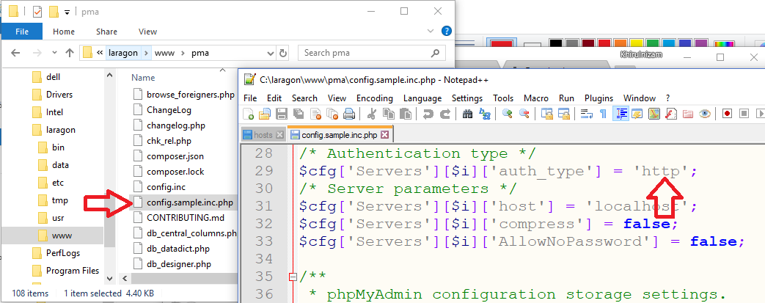
Phpmyadmin config.inc

Slide 17
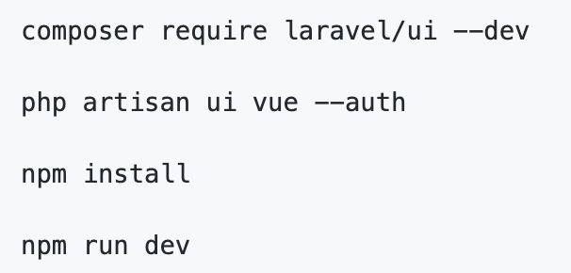
Authentication Module
Laravel makes implementing authentication very simple. In fact, almost everything is configured for you out of the box.

Slide 18
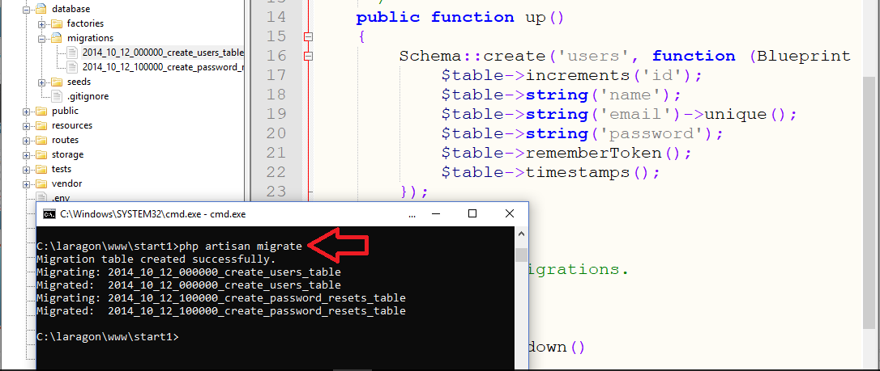
Authentication Module

Slide 19
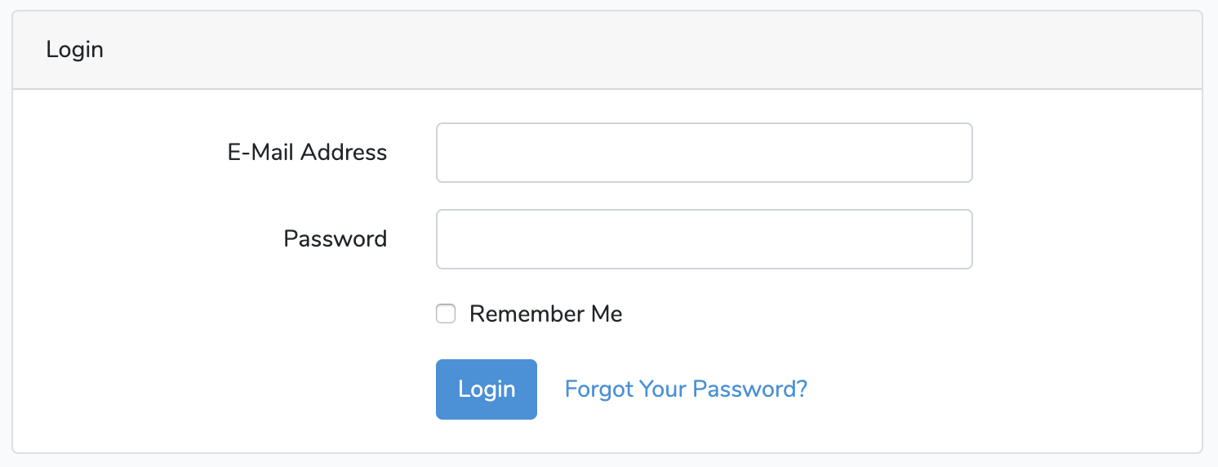
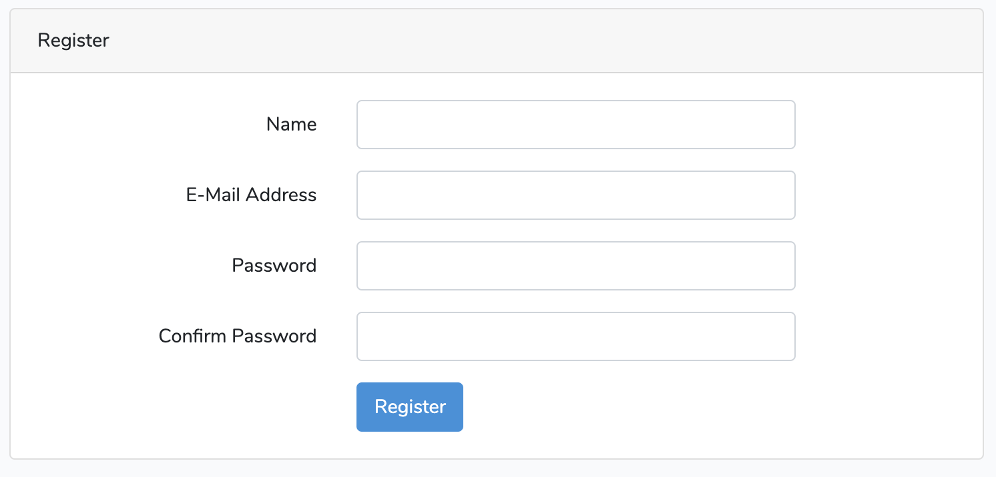
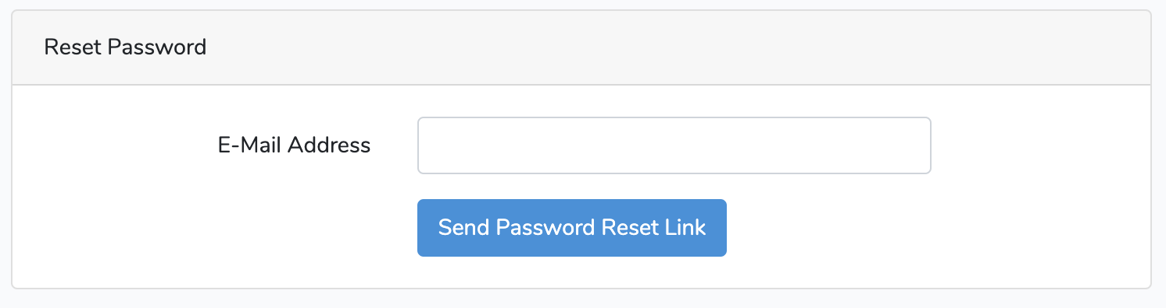

Slide 20


Create a New Record Form github.com/khirulnizam

Slide 21
routes/web.php
app/Http/Controllers
app/Models
resources/views
Notes:
In Slide Show mode, select the arrows to visit links.

Slide 22
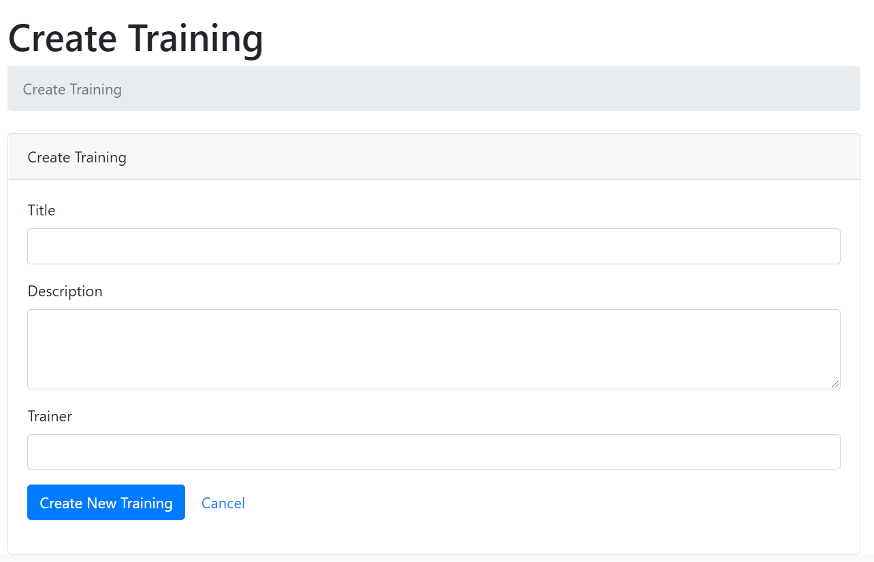
Create new record interface (create.blade.php)

Slide 23
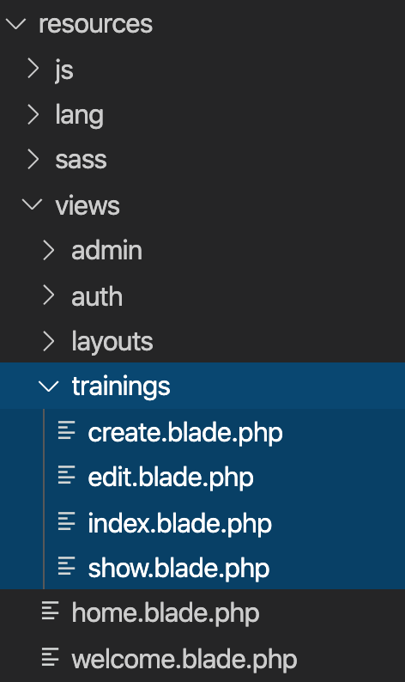
Views
Views contain the HTML served by your application and separate your controller / application logic from your presentation logic.
Views are stored in the resources/views directory
Go to resources/views
Create training folder
Inside training folder, create:
create.blade.php
index.blade.php

Slide 24
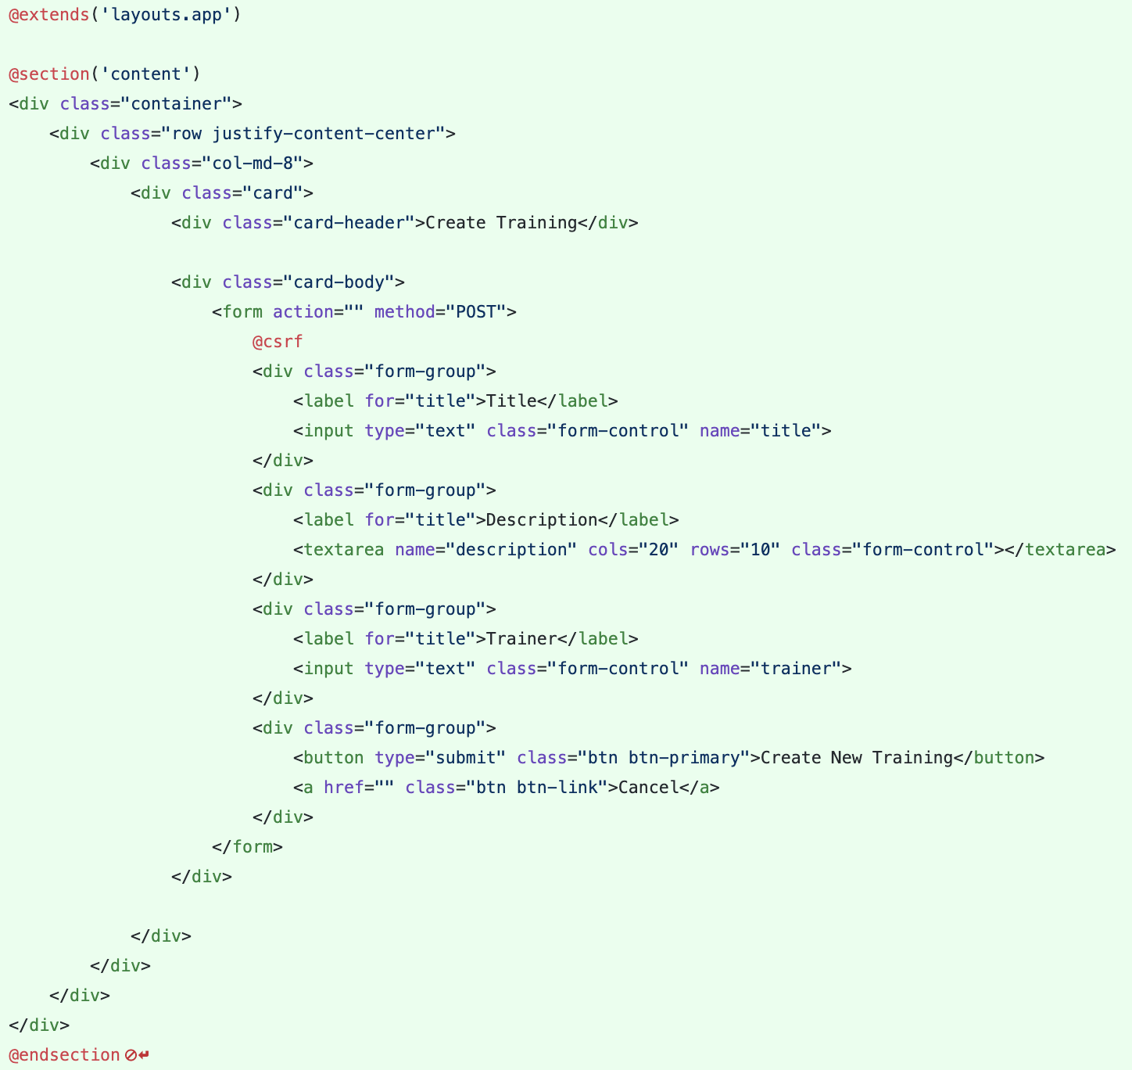
Views – Create View
Views are stored in the resources/views directory
Go to resources/views/trainings/create.blade.php

Slide 25

Controller & Simple Route github.com/khirulnizam

Slide 26
routes/web.php
app/Http/Controllers
app/
resources/views
Notes:
In Slide Show mode, select the arrows to visit links.

Slide 27
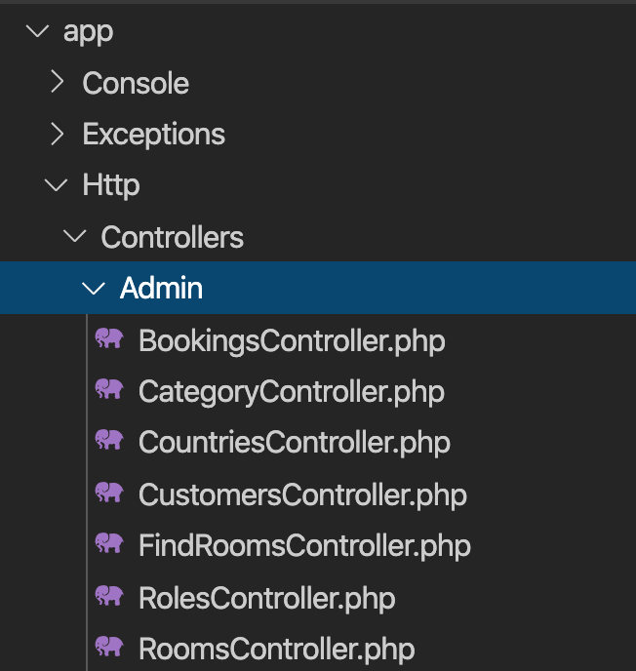
Controller
Instead of defining all of your request handling logic as Closures in route files, you may wish to organize this behavior using Controller classes.
Controllers can group related request handling logic into a single class.
Controllers are stored in the app/Http/Controllers directory.

Slide 28
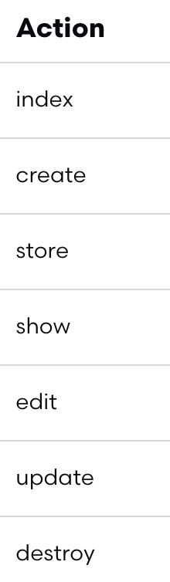
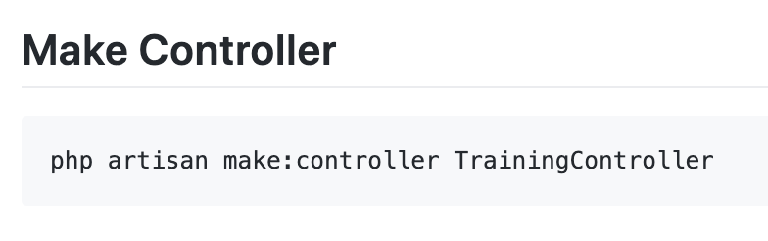
Controller
7 method in controllers

Slide 29
routes/web.php
app/Http/Controllers
app/
resources/views
Notes:
In Slide Show mode, select the arrows to visit links.

Slide 30
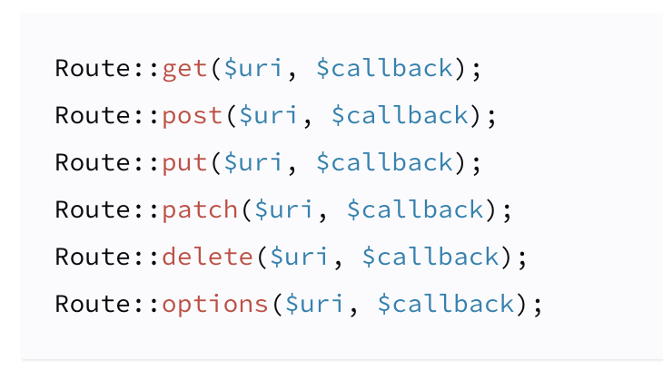
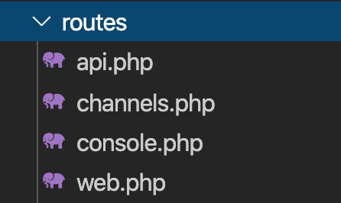
Routing
All Laravel routes are defined in your route files, which are located in the routes directory.
https://laravel.com/docs/6.x/routing.

Slide 31
Simple Routing
All Laravel routes are defined in your route files, which are located in the routes directory.
https://laravel.com/docs/6.x/routing.

Slide 32
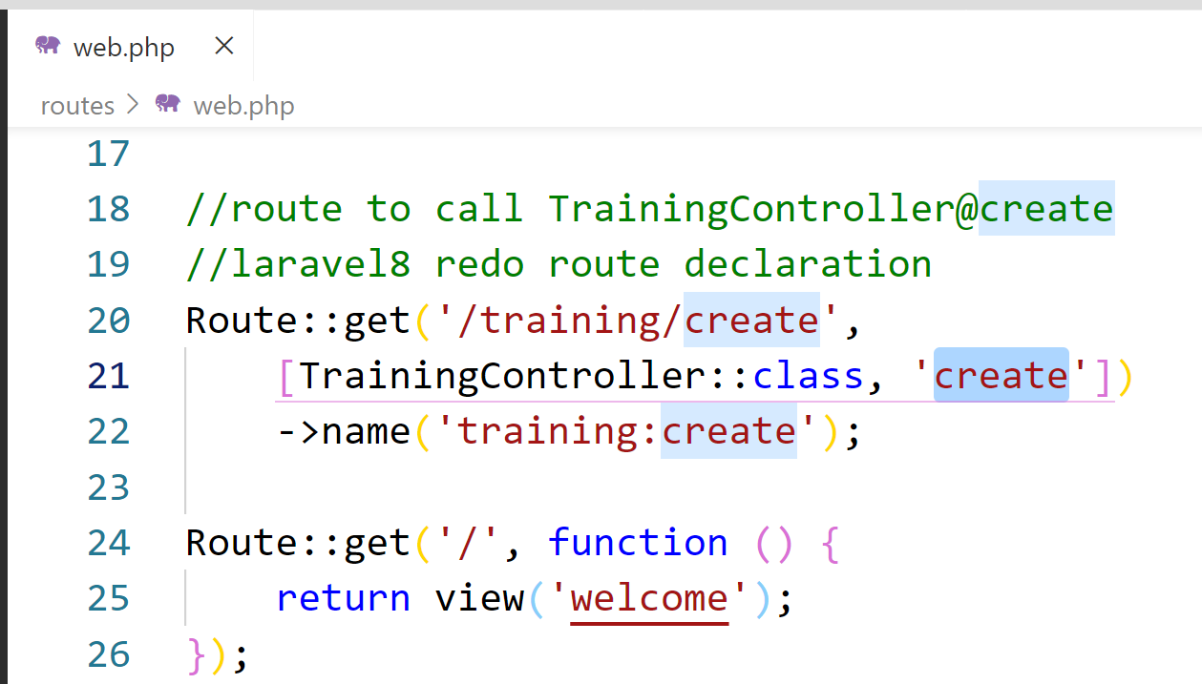
Simple routing ( routes/web.php ) Laravel 8
index

Slide 33
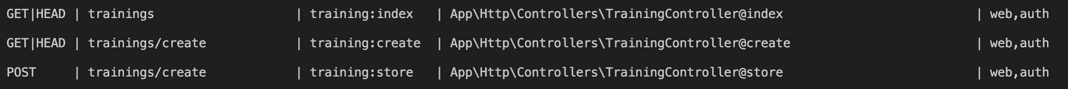
Simple Routing
php artisan route:list
https://laravel.com/docs/6.x/routing.

Slide 34
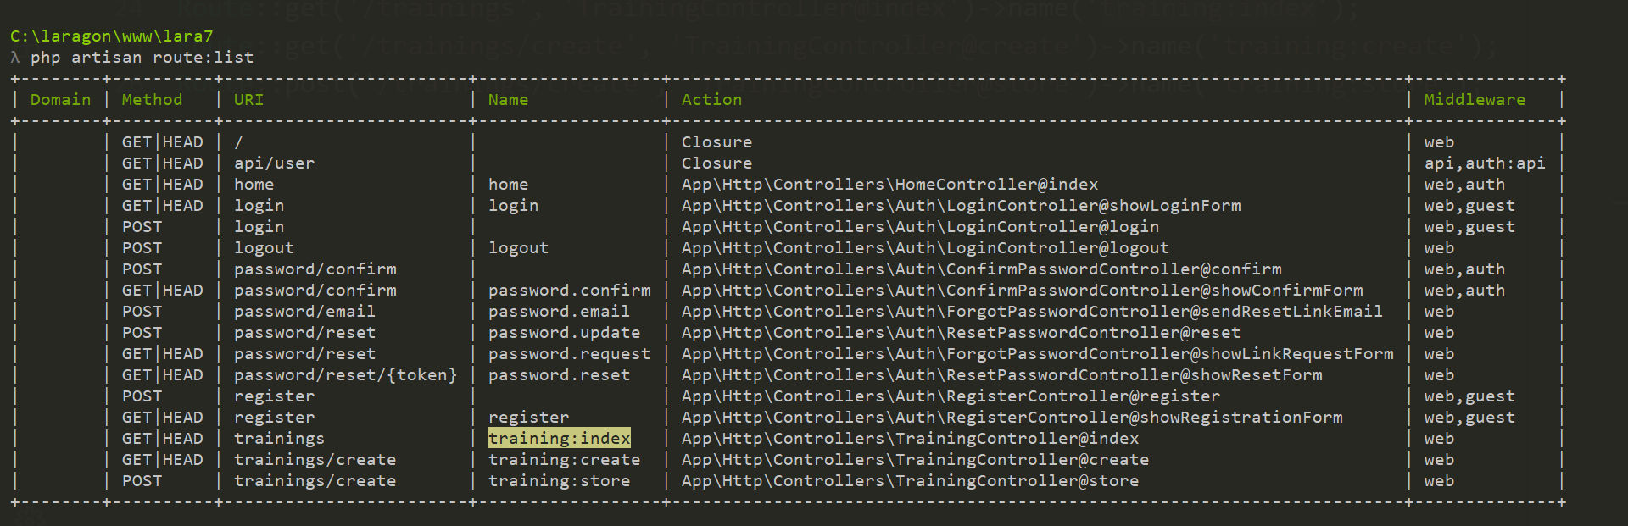
php artisan route:list

Slide 35
Advanced ROUTING: group & named

Slide 36
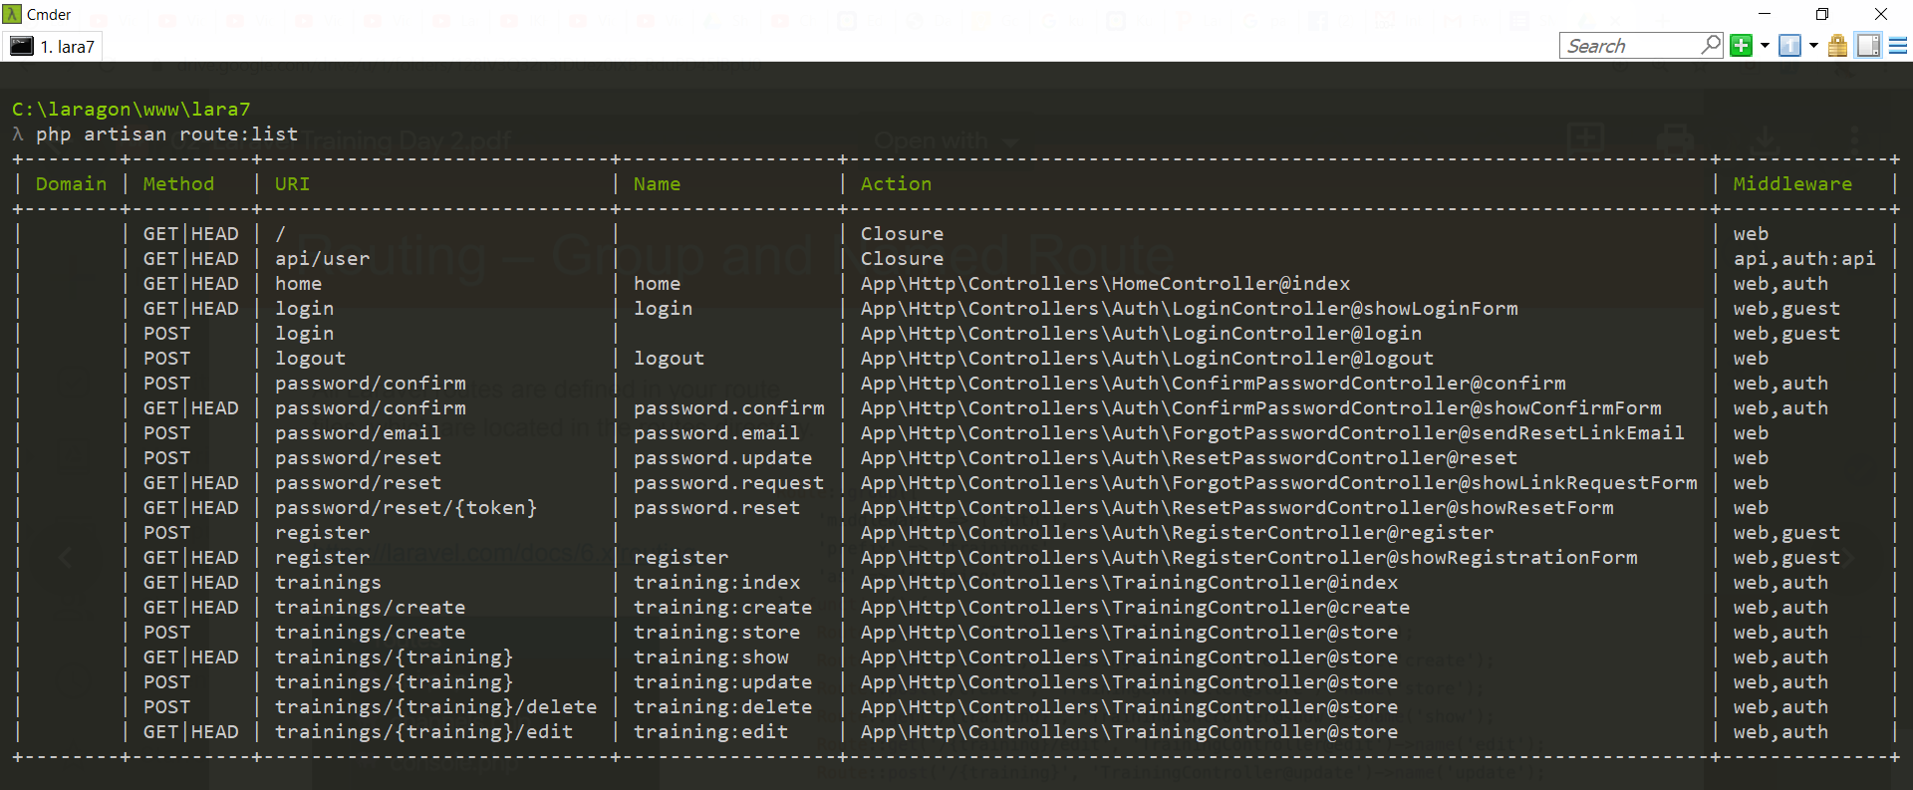
php artisan route:list

Slide 37

Route resource & index github.com/khirulnizam

Slide 38
routes/web.php
app/Http/Controllers
app/Models
resources/views
Notes:
In Slide Show mode, select the arrows to visit links.

Slide 39
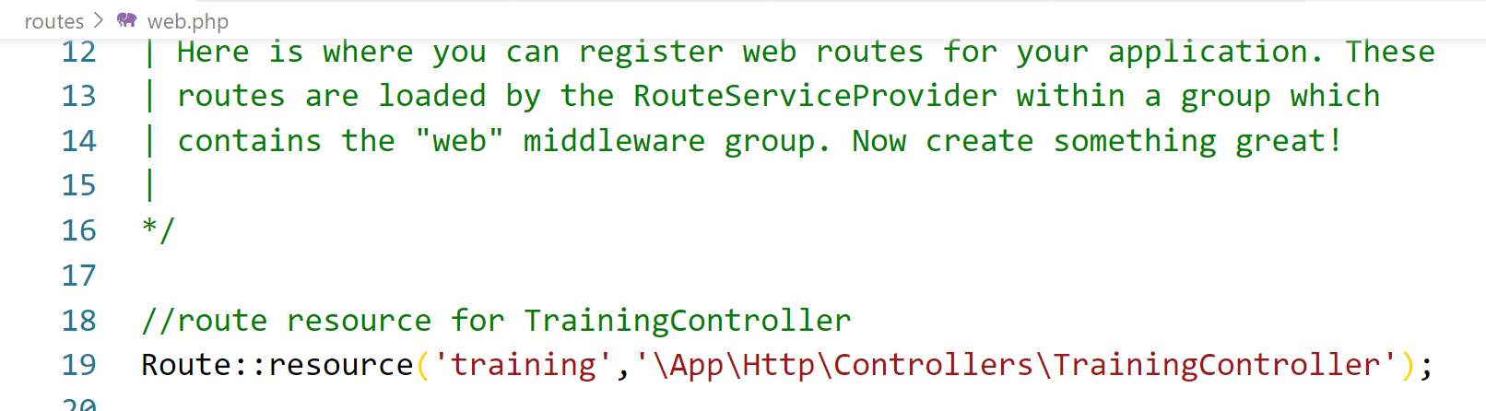
Route resource

Slide 40

Model & Database/Table github.com/khirulnizam

Slide 41
routes/web.php
app/Http/Controllers
app/Models
resources/views
Notes:
In Slide Show mode, select the arrows to visit links.

Slide 42
Create new record interface (create.blade.php)

Slide 43
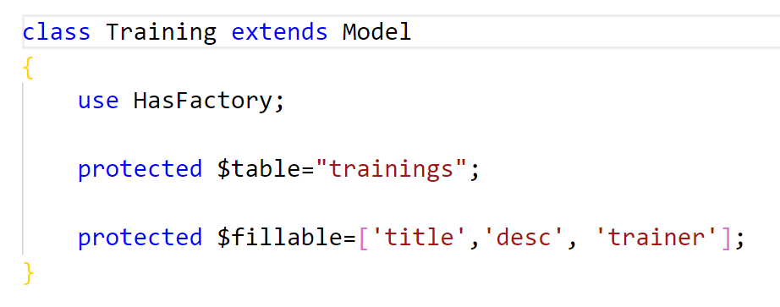
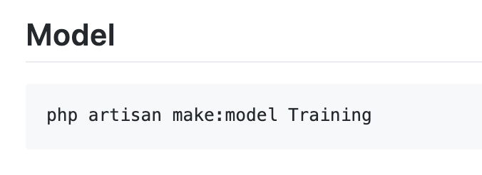
Model
Models typically live in the app directory.
All Eloquent models extend Illuminate\Database\Eloquent\Model class.

Slide 44
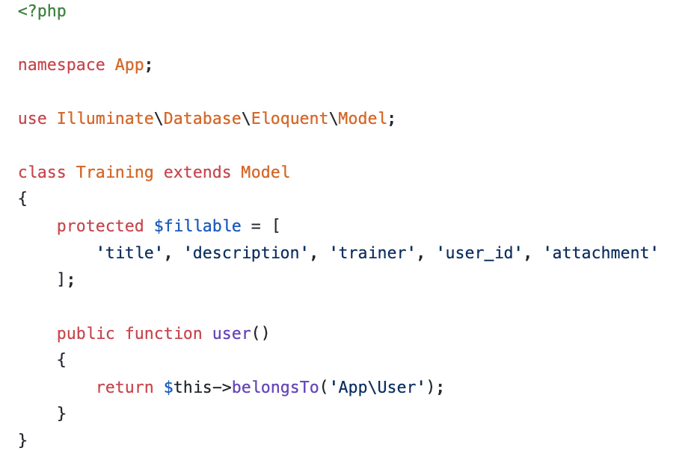
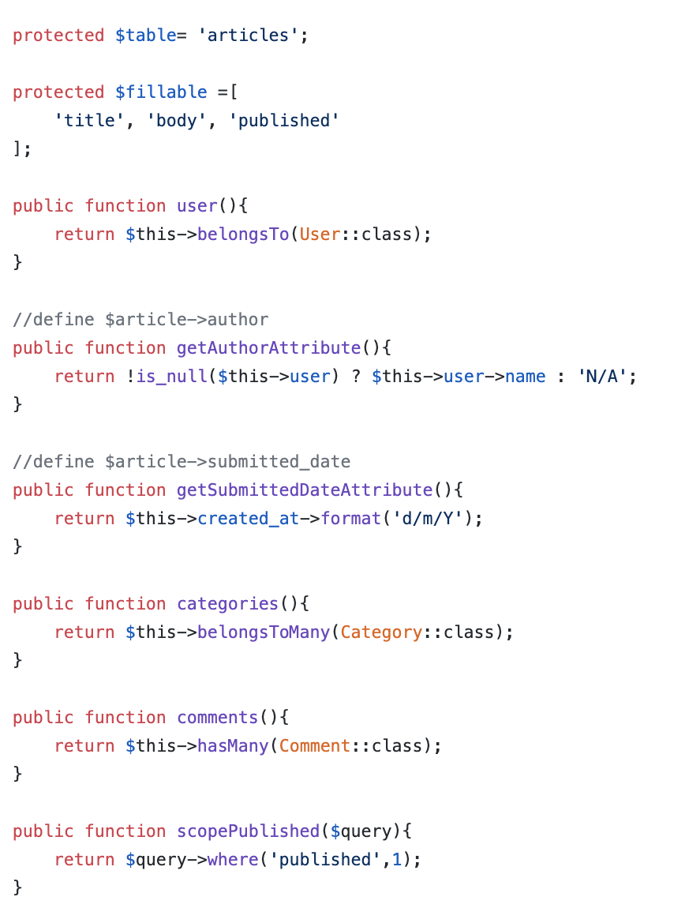
Model
Model used to define fillable attributes.
Model also can be used to define relationship
Model also can be used to to specify custom table.
Model also can be used to define mutator
Model also can be used to define local scope

Slide 45
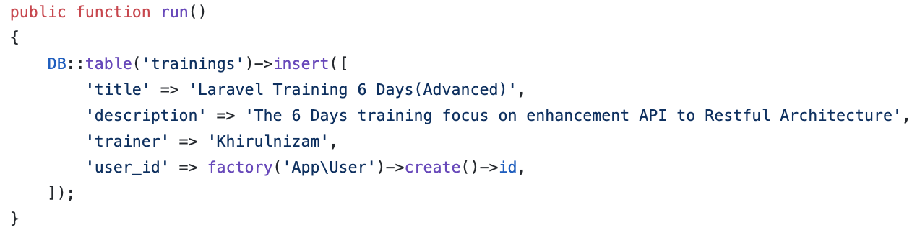
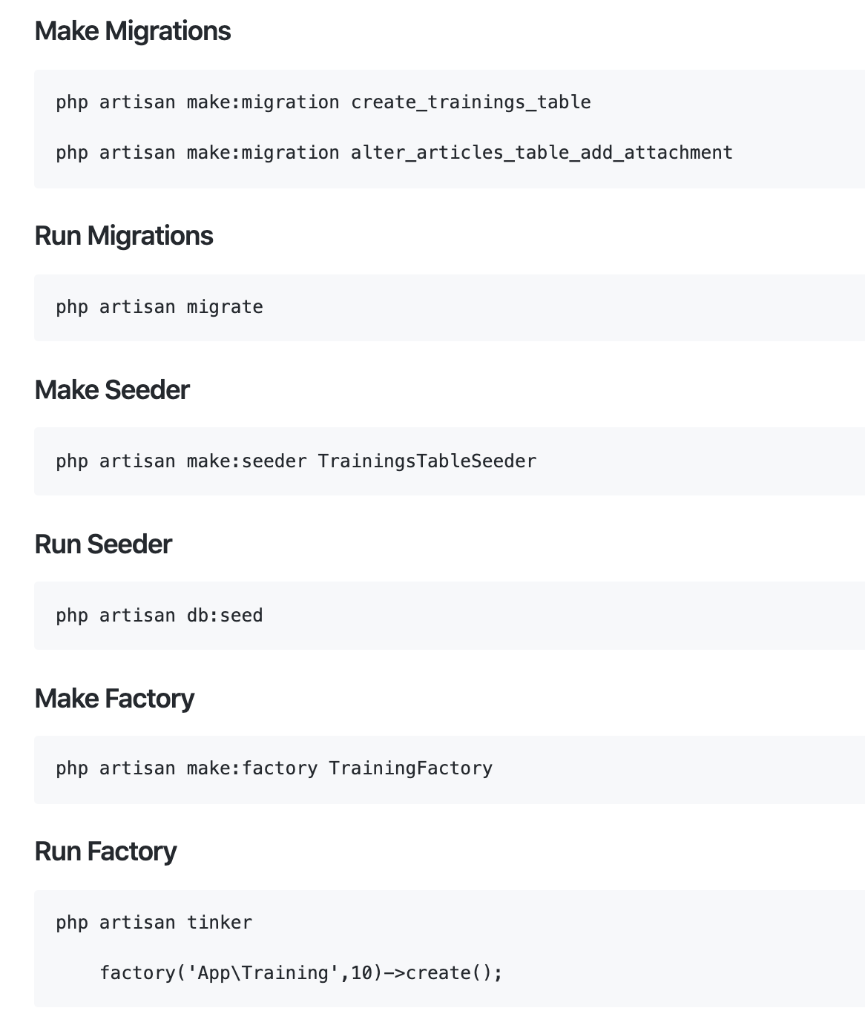
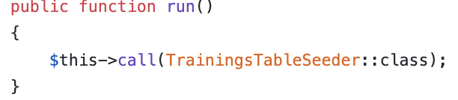
Working with Database
On database/seeds/TrainingsTableSeeder.php
Database Seeds
Laravel includes a simple method of seeding your database with test data using seed classes.
On database/seeds/DatabaseSeeder.php

Slide 46
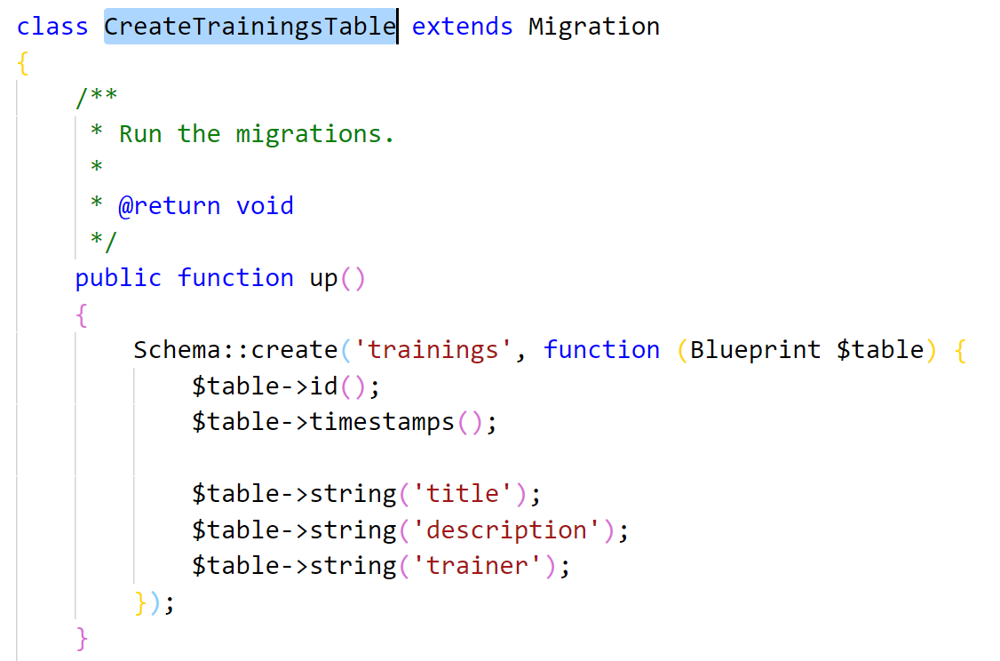
Working with Database
Database Migrations
Migrations are like version control for your database.

Slide 47
php artisan migrate

Slide 48

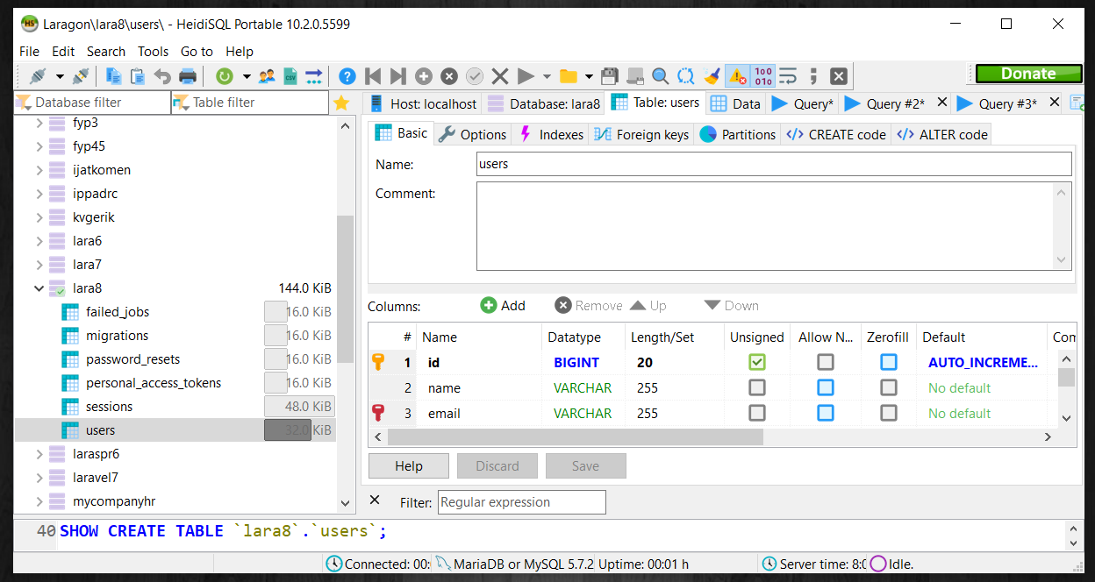
HeidiSQL – heidisql.com

Slide 49
Working with Database : run seeder

Slide 50
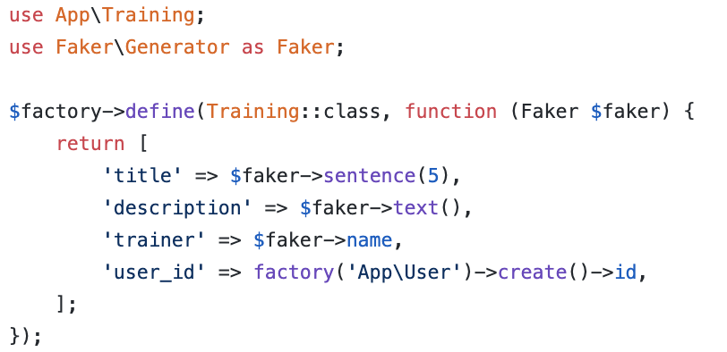
Working with Database
Database Factories
Laravel has a feature called model factories that allows you to build fake data for your models.

Slide 51
How to create and run migrations, seeder and factory?
Here are the example.

Slide 52

Insert Form & Store New Record github.com/khirulnizam

Slide 53
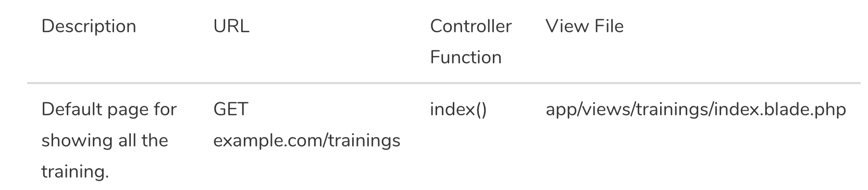
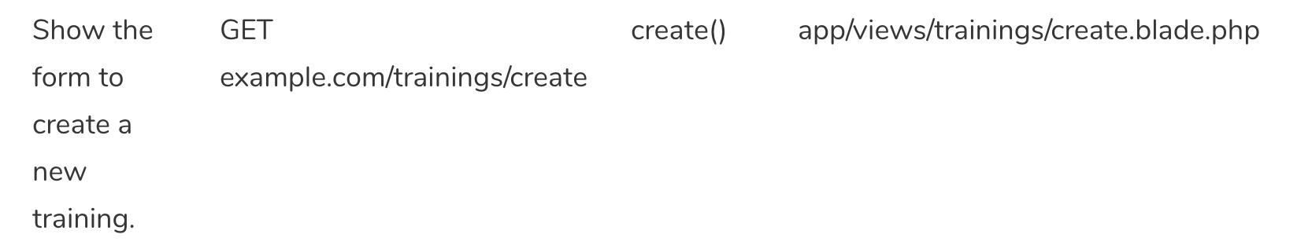
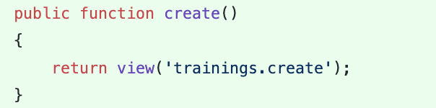
Controller - Create

Slide 54
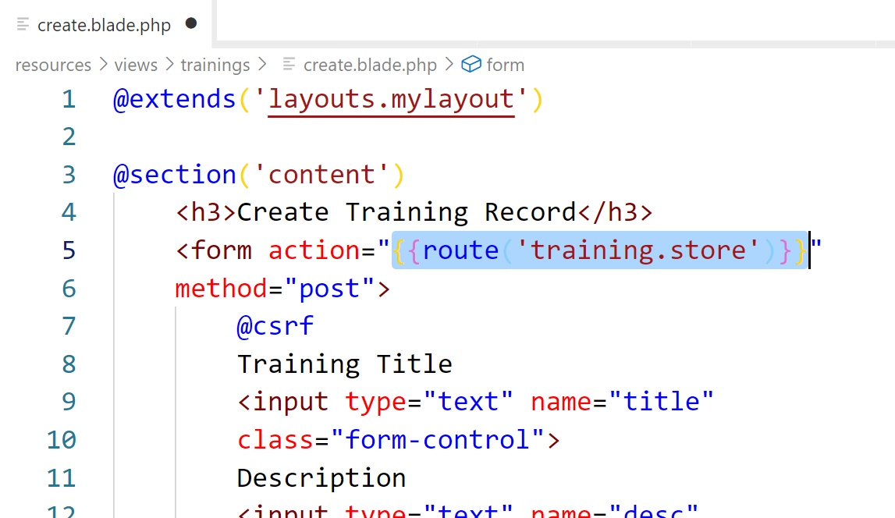
Action path

Slide 55
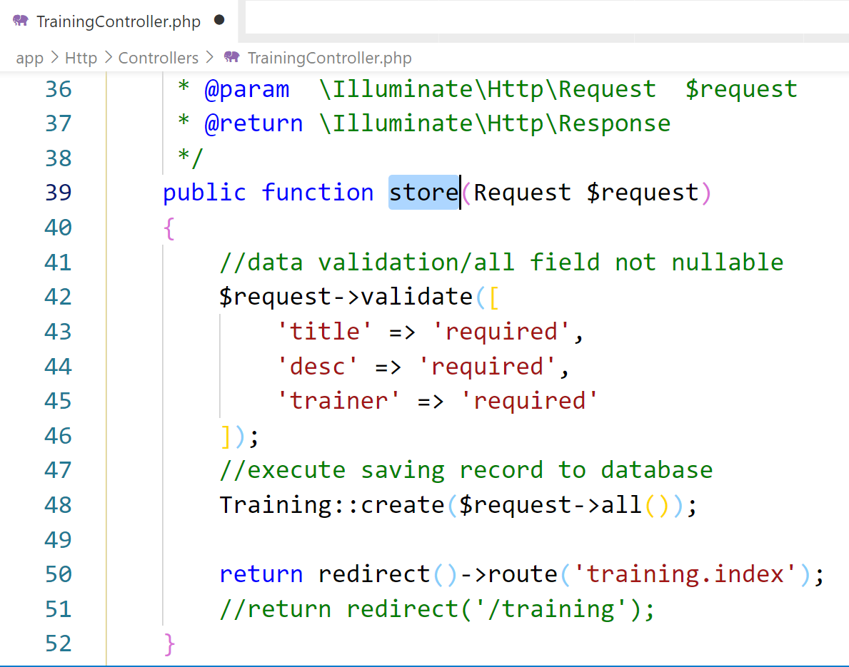
Controller - Store

Slide 56

Browse Records
inside index github.com/khirulnizam

Slide 57
routes/web.php
app/Http/Controllers
app/Models
resources/views
Notes:
In Slide Show mode, select the arrows to visit links.

Slide 58
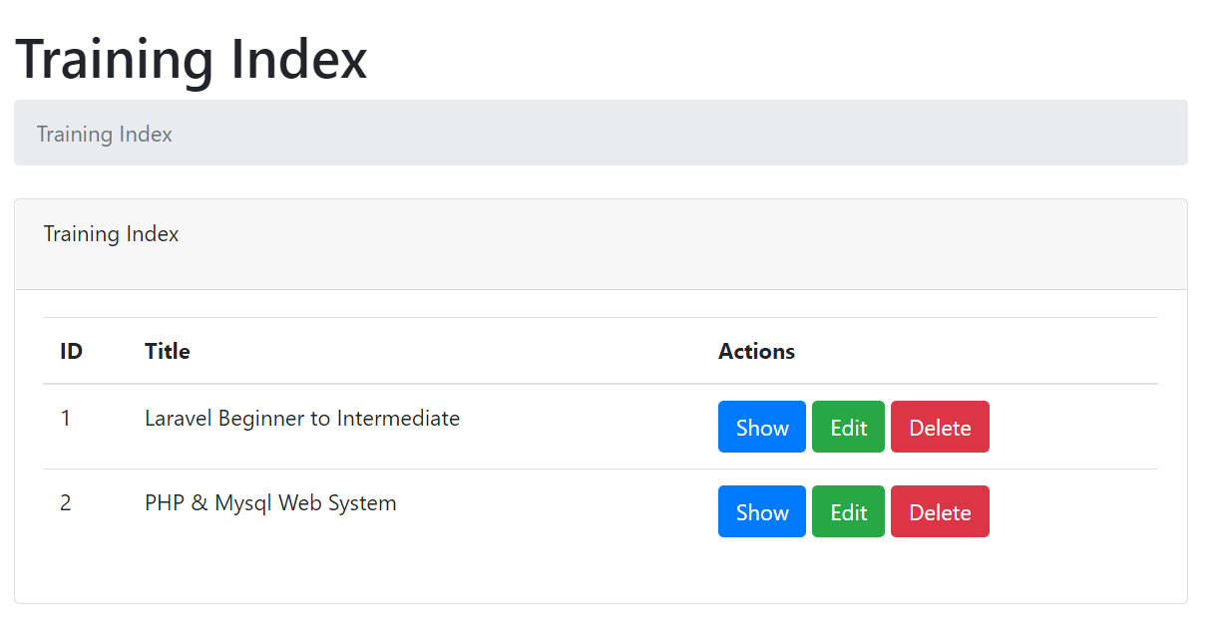
Training index.blade.php

Slide 59
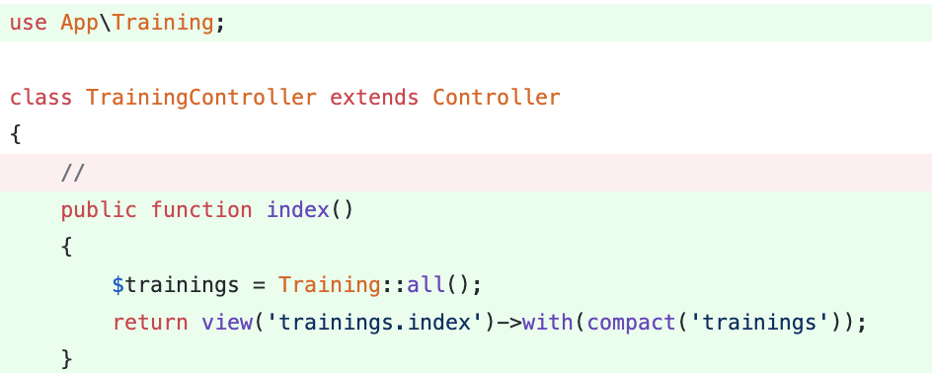
Controller - Index

Slide 60
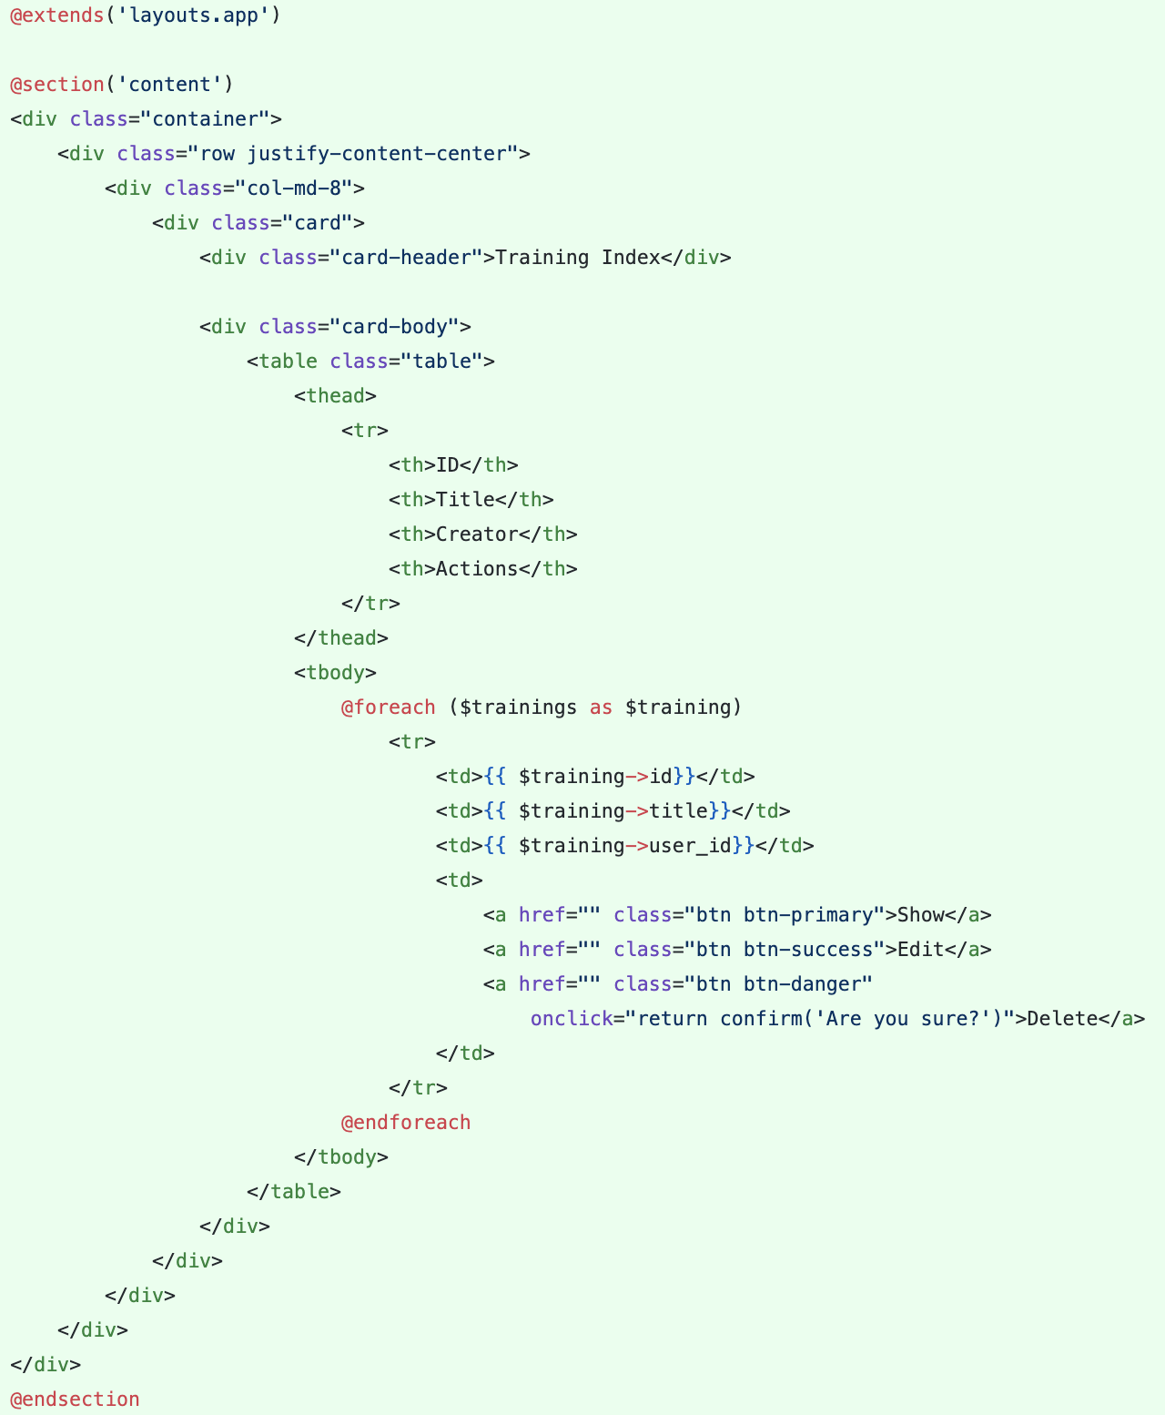
Views – Index View
Views are stored in the resources/views directory
Go to resources/views/trainings/index.blade.php

Slide 62

Pagination &
Search Records
github.com/khirulnizam

Slide 63
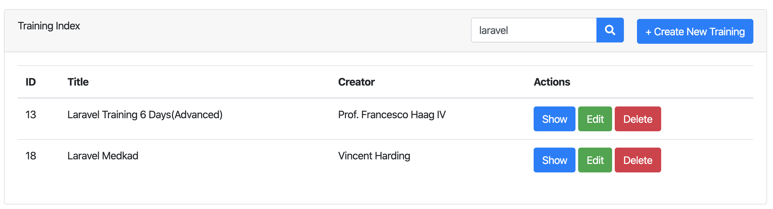
Search
Create form to input keyword
Query the keyword that match with title
https://github.com/samtarmizi/laravel-spr/commit/f5e85dcda0efc4e48186691e3f330f6278dcee52

Slide 64
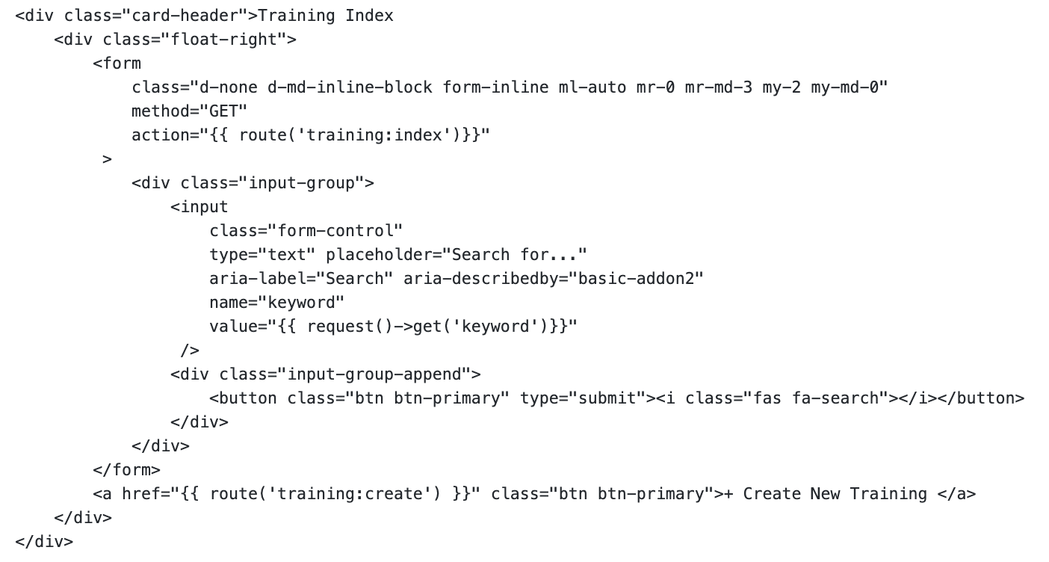
Search - Form
Using GET method to named route training:index

Slide 65
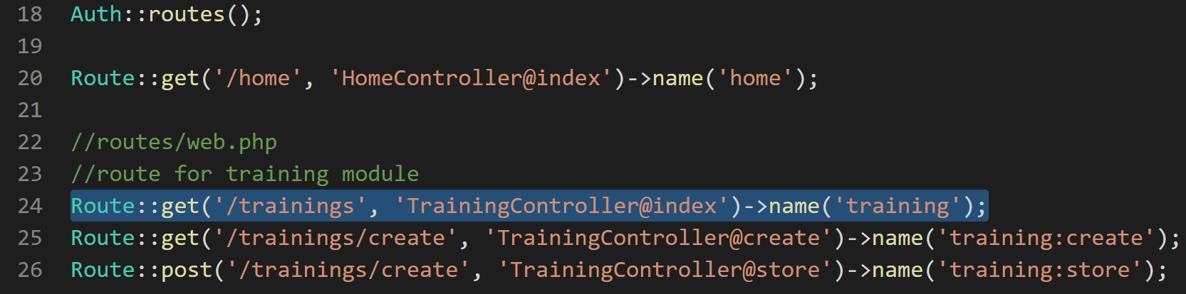
Simple routing ( routes/web.php )
index

Slide 66
Simple Routing
php artisan route:list
https://laravel.com/docs/6.x/routing.

Slide 67
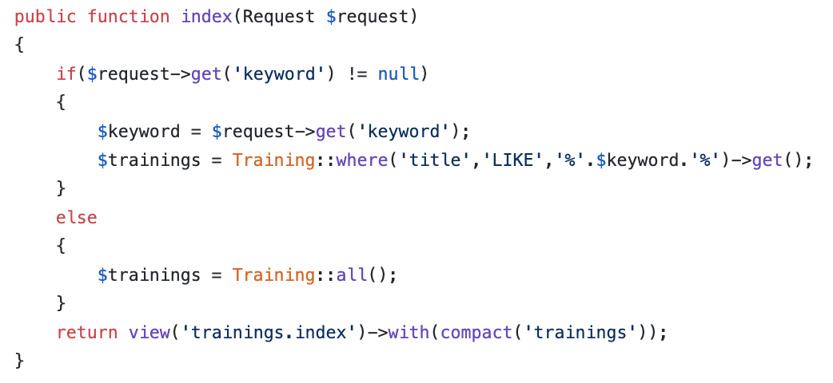
Search – Index Method
Check if there is keyword, if there is keyword on query string, run query to search column where like title.
If no keyword, the method will return collection rows from trainings table.

Slide 68
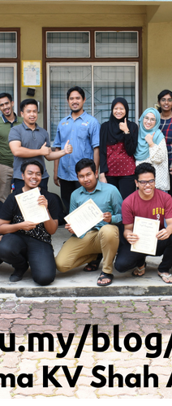

Laravel t08 Pagination
Tarmizi Sanusi
Khirulnizam Abd Rahman
fstm.kuis.edu.my/blog/laravel

Slide 69
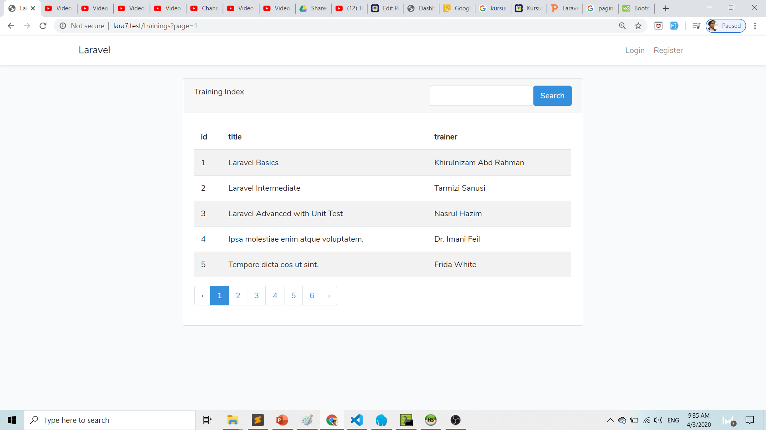

Slide 70


Search - Pagination
The paginate method automatically takes care of setting the proper limit and offset based on the current page being viewed by the user and append with keywords.
https://github.com/samtarmizi/laravel-spr/commit/6b0d8b3c64bd42c58af97fc49b2c48d983273f1d

Slide 71

TrainingController@index

Slide 72
Hacks
Creating Index - https://github.com/samtarmizi/laravel-spr/commit/1c925853f61da081f0e3ce298e58a4a423b66040
Creating Create - https://github.com/samtarmizi/laravel-spr/commit/7a5b5f3b643bcb8a265af3bb9f4e94e3aef95aa1
Creating Store - https://github.com/samtarmizi/laravel-spr/commit/2513b55c65bc4d27afa5004144ee2c7d41b3cbd7

Slide 73

Laravel t10 npm not found
fstm.kuis.edu.my/blog/laravel

Slide 74


npm not found

Slide 75
Authentication Module
Laravel makes implementing authentication very simple. In fact, almost everything is configured for you out of the box.

Slide 76

Laragon
Includes NODEJS

Slide 77

Terminal in Laragon
Laravel makes implementing authentication very simple. In fact, almost everything is configured for you out of the box.

Slide 78

Locate nodejs in Laragon

Slide 79

Environment variables

Slide 80

Set path to nodejs

Slide 81

NODEJS.ORG

Slide 82

Laravel t11 Middleware enforced Auth
fstm.kuis.edu.my/blog/laravel

Slide 83

Middleware
Middleware provide a convenient mechanism for filtering HTTP requests entering your application.
For example, Laravel includes a middleware that verifies the user of your application is authenticated. If the user is not authenticated, the middleware will redirect the user to the login screen.

Slide 84

Add to dashboard menu

Slide 85

Laravel t12 Test Laravel project from Github repo

Slide 86
NODEJS.ORG

Slide 87

Github.com/khirulnizam/lara7

Slide 88

Git clone

Slide 89

composer & npm install

Slide 90

.env file

Slide 91
php artisan migrate & seed
Inside Laravel project folder
php artisan key:generate
php artisan migrate
php artisan db:seed

Slide 92
Laravel t13 Show records (Paparan semua data dalam rekod)

Slide 93

Table with lots of column

Slide 94
Github.com/khirulnizam/lara7
Slides & codes

Slide 95
DISCLAIMER
Codes are for demo purposes. Example showed here are only to validate the proof of concepts. Security aspect the demonstrated examples are beyond the coverage of these video tutorials. You are advised to explore / sought after advanced/security topics of PHP web programming as these tutorials only for beginner level.
Suitable to view in DESKTOP

Slide 96
Views
Views are stored in the resources/views directory
Go to resources/views
Go to trainings folder, create:
show.blade.php
edit.blade.php

Slide 97
Controller
7 method in controllers

Slide 98
routes/web.php
app/Http/Controllers
app/
resources/views
Notes:
In Slide Show mode, select the arrows to visit links.

Slide 99


Controller - Show

Slide 100
Views – Show View
Views are stored in the resources/views directory
Go to resources/views/trainings/show.blade.php

Slide 101

Github.com/khirulnizam/lara7

Slide 102
Github.com/khirulnizam/lara7
Slides & codes

Slide 103


Laravel t14 Font-awesome thru CDN (Pasang icon font-awesome guna CDN)

Slide 104
Github.com/khirulnizam/lara7
Slides & codes

Slide 105

CDN – CONTENT DELIVERY NETWORK
CDN – load library/ framework from public host server
to provide high availability and performance
https://www.bootstrapcdn.com/fontawesome/

Slide 106

FONTAWESOME IN SIMPLE HTML

Slide 107

Import font-awesome from CDN

Slide 108

Tag: <i></i>
<i class="fa fa-file-text"></i>
<p>Used on a button:</p>
<button>
Show <i class="fa fa-file-text"></i>
</button>

Slide 109

Import font-awesome CDN in Laravel layout

Slide 110
https://www.bootstrapcdn.com/fontawesome/

Slide 111

Implement in buttons

Slide 112
Github.com/khirulnizam/lara7
Slides & codes

Slide 113
Laravel t15 Edit/Update (Kemaskini data dalam rekod)

Slide 114

UPDATE RECORD PROCESS
Index (choose )
id
Edit (form)
id
Update (save)

Slide 115
DISCLAIMER
Codes are for demo purposes. Example showed here are only to validate the proof of concepts. Security aspect the demonstrated examples are beyond the coverage of these video tutorials. You are advised to explore / sought after advanced/security topics of PHP web programming as these tutorials only for beginner level.
Suitable to view in DESKTOP

Slide 116
Github.com/khirulnizam/lara7
Slides & codes
T12 Tutorial clone/download github repo

Slide 117


Controller - Edit

Slide 118
Views – Edit View
Views are stored in the resources/views directory
Go to
resources/views/trainings/edit.blade.php

Slide 119


Slide 120


Controller - Update

Slide 121


Output screen

Slide 122
W09 Delete records (Padam rekod)

Slide 123
DISCLAIMER
Codes are for demo purposes. Example showed here are only to validate the proof of concepts. Security aspect the demonstrated examples are beyond the coverage of these video tutorials. You are advised to explore / sought after advanced/security topics of PHP web programming as these tutorials only for beginner level.
Suitable to view in DESKTOP

Slide 124
Github.com/khirulnizam/lara7
Slides & codes
T12 Tutorial clone/download github repo

Slide 125

Overview

Slide 126

Delete button inside FORM

Slide 127

Routing – Group and Named Route
All Laravel routes are defined in your route files, which are located in the routes directory.
https://laravel.com/docs/7.x/routing.

Slide 128

Routing – Group and Named Route
php artisan route:list
https://laravel.com/docs/7.x/routing.

Slide 129


Controller – Destroy/Delete

Slide 130
Laravel t17 @csrf (Built-in security token for post method) bit.ly/fstmtubelaravel

Slide 131
DISCLAIMER
Codes are for demo purposes. Example showed here are only to validate the proof of concepts. Security aspect the demonstrated examples are beyond the coverage of these video tutorials. You are advised to explore / sought after advanced/security topics of PHP web programming as these tutorials only for beginner level.
Suitable to view in DESKTOP

Slide 132
Github.com/khirulnizam/lara7
Slides & codes
T12 Tutorial clone/download github repo

Slide 133

What is CSRF?
OWASP.org
Cross-Site Request Forgery
- is an attack that forces an end user to execute unwanted actions on a web application in which they're currently authenticated.

Slide 134


Implementation in Laravel blade

Slide 135



Location of csrf app_key
Use to hash security token

Slide 136



Pasang layout Bootstrap baru dalam Laravel (Apply Bootstrap Layout)

Slide 137

Output overview

Slide 138
DISCLAIMER
Codes are for demo purposes. Example showed here are only to validate the proof of concepts. Security aspect the demonstrated examples are beyond the coverage of these video tutorials. You are advised to explore / sought after advanced/security topics of PHP web programming as these tutorials only for beginner level.
Suitable to view in DESKTOP

Slide 139

Github.com/khirulnizam/lara8
Slides & codes
T12 Tutorial clone/download github repo

Slide 140

Theme from https://startbootstrap.com/themes/landing-page/

Slide 141

Asset/resources for template

Slide 142

Blade asset( ) function – apply on both css & js

Slide 143

@yield( )

Slide 144


@yield( )

Slide 145
Output overview

Slide 146

landingpage.blade.php

Slide 147

route/web.php

Slide 148
Github.com/khirulnizam/lara8
Slides & codes
T12 Tutorial clone/download github repo

Slide 149
Laravel t19 Apply Bootstrap on Admin Dashboard (Pasang layout Bootstrap baru pada Panel Admin)

Slide 150

Output overview

Slide 151
DISCLAIMER
Codes are for demo purposes. Example showed here are only to validate the proof of concepts. Security aspect the demonstrated examples are beyond the coverage of these video tutorials. You are advised to explore / sought after advanced/security topics of PHP web programming as these tutorials only for beginner level.
Suitable to view in DESKTOP

Slide 152
Github.com/khirulnizam/lara7
Slides & codes
T12 Tutorial clone/download github repo

Slide 153

Theme from https://startbootstrap.com/themes/sb-admin-2/

Slide 154

Asset/resources for template

Slide 155

First time display the new template

Slide 156

Blade asset( ) function – apply on both css & js

Slide 157

@yield( )

Slide 158


@yield( )
@yield( )

Slide 159
Output overview

Slide 160

index.blade.php

Slide 161
Github.com/khirulnizam/lara7
Slides & codes
T12 Tutorial clone/download github repo

Slide 162
Laravel t20
Muat naik fail gambar

Slide 163


Upload image
Show uploaded image
Upload image

Slide 164
DISCLAIMER
Codes are for demo purposes. Example showed here are only to validate the proof of concepts. Security aspect the demonstrated examples are beyond the coverage of these video tutorials. You are advised to explore / sought after advanced/security topics of PHP web programming as these tutorials only for beginner level.
Suitable to view in DESKTOP

Slide 165
Github.com/khirulnizam/lara7
Slides & codes
T12 Tutorial clone/download github repo

Slide 166

Add column to table trainings
Field to hold image’s filename

Slide 167

Additional field to table trainings

Slide 168

function up() – additional migration file

Slide 169

php artisan migrate

Slide 170

create.blade.php – to select and upload image
Upload image

Slide 171

Add enctype in create.blade.php

Slide 172

Add input type=“file” in create.blade.php

Slide 173

app/Training.php - Add fillable for the fields

Slide 174

Validate uploaded file type

Slide 175

TrainingController@store – validate file type

Slide 176

TrainingController@store – continued…

Slide 177


Storage not found

Slide 178

Configuring Filesystem for Storage config/filesystems.php

Slide 179

File Storage
Create Symbolic Link
The public disk is intended for files that are going to be publicly accessible.
By default, the public disk uses the local driver and stores these files in storage/app/public.
To make them accessible from the web, you should create a symbolic link from public/storage to storage/app/public.

Slide 180

Virtual link of public file storage

Slide 181

Physical link of public file storage
The actual physical location of the file storage
To make them accessible from the web, you should create a symbolic link from public/storage to storage/app/public.

Slide 182

create.blade.php - Display validation errors

Slide 183
Github.com/khirulnizam/lara7
Slides & codes
T12 Tutorial clone/download github repo

Slide 184
Laravel t21 Table relationship (Jadual dengan perhubungan 1-Many)

Slide 185
Laravel t22 Insert record with drop down data option (Masukkan data baharu dengan jadual berhubungan)

Slide 186
Laravel t23 Upload record with file (Muat naik sebarang fail)

